Slide 1
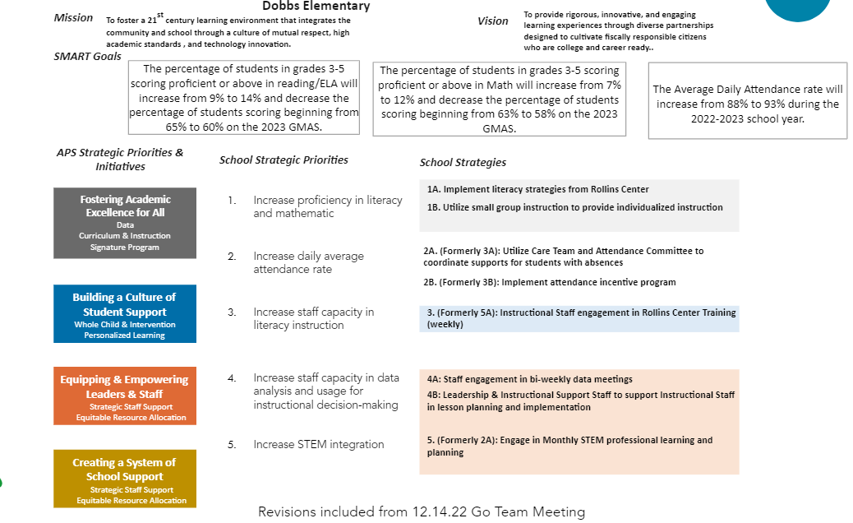
Revised Strategic Plan (From Go Team Feedback)

Slide 2
Meeting Calendar Review and Update
Meeting #1 – Sept. 7, 2022
Meeting #2 – Nov. 7, 2022 (Mon.)
Meeting #3 – Dec. 14, 2022 (Wed.)
Meeting #4 – Jan. 30, 2023 (Mon.)
Meeting #5 – Feb. 13, 2023 (Mon.)
Meeting #6 – Mar. 22, 2023 (Wed.) – (Has to occur prior to March 17th)
Proposed dates – Monday, March 13th or Wednesday, March 15th

Slide 3
Tech Fair Winners
Dobbs | Grades 03~04 | Video Production | 2nd | Team
Dobbs | Grades 03~04 | Video Production | 2nd | Team
Dobbs | Grades 05~06 | Robotics | 2nd | Individual
Dobbs | Grades 05~06 | Graphic Design | 2nd | Individual
Dobbs | Grades 05~06 | Robotics | 3rd | Team
Dobbs | Grades 05~06 | Robotics | 3rd | Team
Science Fair Winners
3 students – All placed 2nd!
Will attend District Awards Ceremony.
Spelling Bee Winner!
Placed 2nd in District Spelling Bee

Slide 4
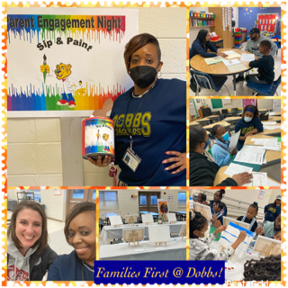
Academic Family Engagement
Sip & Paint

